Slide 1
Quasi-Recurrent Neural Networks
James Bradbury, Stephen Merity, Caiming Xiong & Richard Socher

Slide 2
RNN&&CNN
RNN:
pros: make the full use of the dependency relation of the sentense and has a better sequence representation power.
cons: the computation cannot occur in parallel.
CNN:
pros: the computation can occur in parallel and improve the learning speed.
cons: can not catch the sequential dependency relation.

Slide 3
Motivation
Address both drawbacks of standard model
QRNN:
1.Allow for parallel computation across timestep
2.Allow the output to depend on the overall order of elements in the sequence.

Slide 4
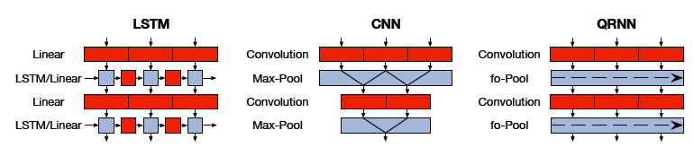
LSTM&&CNN&&QRNN

Slide 5
Model
Each QRNN layer consists of two subcomponents: analyous to convolution and pooling layer in CNNs.
Convolution component:allow parallel computation across minibatches and spatial dimensions.
Pooling component: allow parallel computation across minibatches and feature dimensions.

Slide 6
Model
Convolution operation:
Input: a sequence of n-dimensional vectors x1,x2,...,xT.
Filter num: m
Output: a sequence of m-dimensional vectors z1,z2,...,zT.

Slide 7
Model-Convolution Layer
How to T -> T?
Filter width: 2
Maskd Convolution
Each zt depends only on through
z1
z2
z3
zT
P
x1
x2
x3
.......
xT

Slide 8
Model-Convolution Layer
How to n -> m?
filter num:m filter width:2
x1
f1
..........
x2
f2
x3
........
........
xT
fm

Slide 9
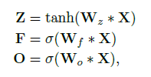
Model-Convolution Layer
Apply additional convolutions with separate to obtain forget gates and output gates that are needed for the pooling function.
The full set of computations in the convolutional component:
Wz,Wf and Wo are filter bank and * denotes a masked convolution operation.

Slide 10
Model-Pooling Layer
It is called “dynamic average pooling”
ht-1
ht
ht+1
ft
zt

Slide 11



Model-Pooling Layer
f-pooling:
fo-pooling:
ifo-pooling:

Slide 12
Variants
Regularization
dropout:stochastically drop som units
zoneout:stochastically forces some hidden units to maintain their previous values
QRNN adopts zoneout to modifying the pooling function.

Slide 13
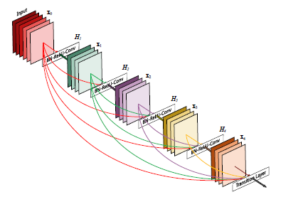
Variants
Densely-Connected Layers
This is equivalent to concatenating each QRNN layer’s input to its output along the channel dimension before feeding the state into the next layer.
dense convolution

Slide 14
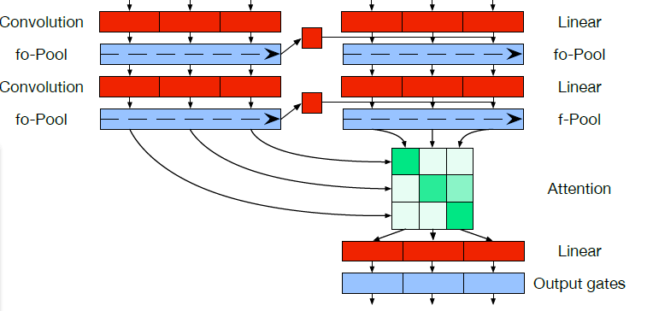
Variants
Encoder–Decoder Models

Slide 15
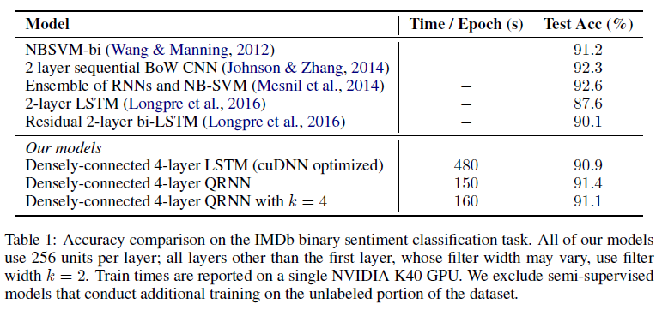
EXPERIMENTS
SENTIMENT CLASSIFICATION

Slide 16
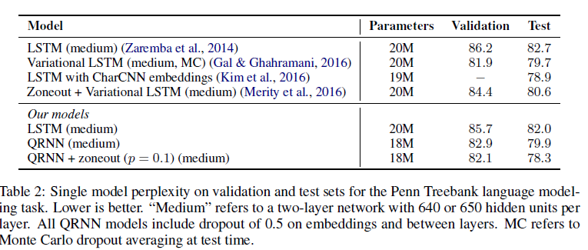
EXPERIMENTS
LANGUAGE MODELING

Slide 17
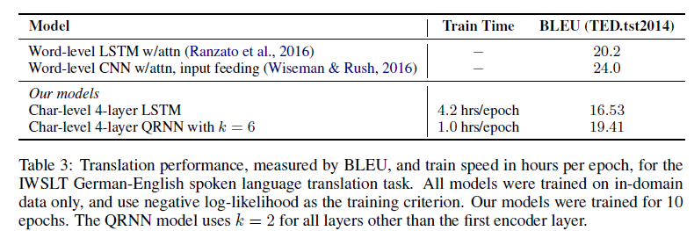
EXPERIMENTS
CHARACTER-LEVEL NEURAL MACHINE TRANSLATION

Slide 18
Conclusion
QRNNs exploit both parallelism and context, exhibiting advantages from both convolutional and recurrent neural networks.

